Slide 1

Domain-Specialized Embedding Learning for Medical Retrieval-Augmented Generation (RAG)
Aswini Sivakumar, Vishwa Gosavi
Presented to: Dr. Tianle Ma
School of Engineering and Computer Science
Oakland University
April 14, 2026

Slide 2

Introduction
Large Language Models (LLMs)
Strong capabilities in natural language understanding and generation
Increasingly used in biomedical QA and clinical NLP
Clinical challenge
LLMs can produce hallucinated or factually incorrect responses
High-stakes domains require recent, accurate, evidence-grounded outputs
The RAG solution
Retrieval Augmented Generation (RAG) reduces hallucinations by grounding answers in verified external knowledge
The Bottleneck
RAG is only as good as the document it retrieves.
If retrieval fails, the entire system fails
Notes:
We need systems that are not just smart, but trustworthy.
AI Spectrum
ANI: Narrow, task-specific Intelligence
AGI: Human-level general Intelligence
ASI: Beyond human Intelligence

Slide 3
Problem Statement
The Problem:
Most RAG systems rely on generic embedding models that are not optimized for complex biomedical language
This leads to:
Poor understanding of clinical terminology and abbreviations
Weak semantic matching between user queries and medical texts
Lower retrieval relevance
The cascading effect:
Low‑quality retrieval → low‑quality generation (even with a strong LLM).
The result is less faithful, less trustworthy medical answers
Can domain-specific embedding models significantly improve retrieval quality and reduce hallucinations in medical Retrieval-Augmented Generation (RAG) systems?
Notes:
We need systems that are not just smart, but trustworthy.
AI Spectrum
ANI: Narrow, task-specific Intelligence
AGI: Human-level general Intelligence
ASI: Beyond human Intelligence

Slide 4
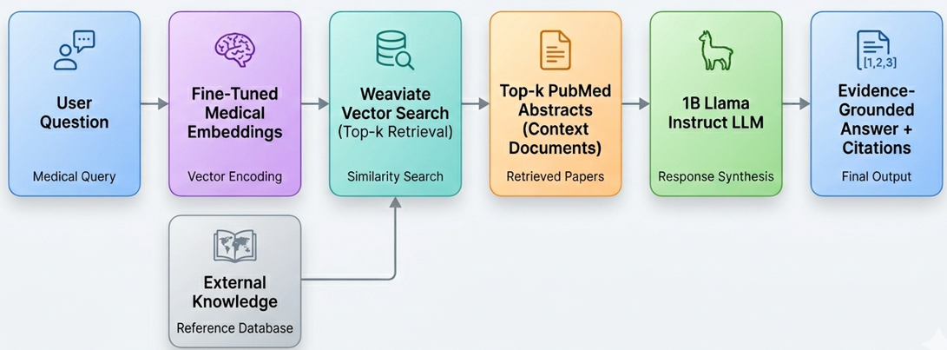
What is RAG?
Retrieval Augmented Generation (RAG) is a framework that combines
Information retrieval
Language generation
Rather than relying solely on internal memory, the model generates responses grounded in external evidence.

Slide 5
System Architecture
External Knowledge: The external knowledge files are chunked, indexed and loaded to vector database
User query: A medical question is entered by the user.
Embedding Model: Converts query into a dense vector using our fine‑tuned medical embeddings.
Vector Search (Weaviate): Performs similarity search to retrieve top‑k relevant PubMed abstracts.
Context Assembly: High‑quality biomedical evidence used as context.
LLM Synthesis: LLM processes the context to generate an evidence-grounded answer.
Notes:
We need systems that are not just smart, but trustworthy.
AI Spectrum
ANI: Narrow, task-specific Intelligence
AGI: Human-level general Intelligence
ASI: Beyond human Intelligence

Slide 6
Components of RAG
Vector Database (Weaviate)
Store document embeddings
Enables fast semantic search
Retriever (Embedding Model)
Searches for relevant documents
Uses semantic similarity
Returns top-k similar content
Generator (LLM)
Ingests the query and retrieved context
Performs reasoning over evidence to generate a grounded response

Slide 7
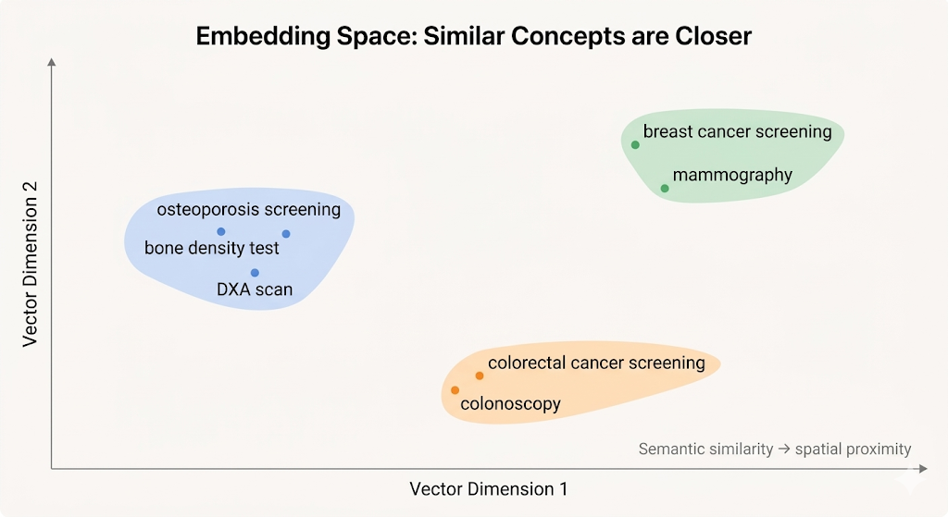
Embedding model
What is the purpose of an embedding model?
Convert text to dense vectors
Places similar concepts closer in the vector space
Captures semantic meaning
Used for retrieval and similarity search
How is it different from the LLM?
Embedding model → Search brain
LLM → Reasoning brain

Slide 8
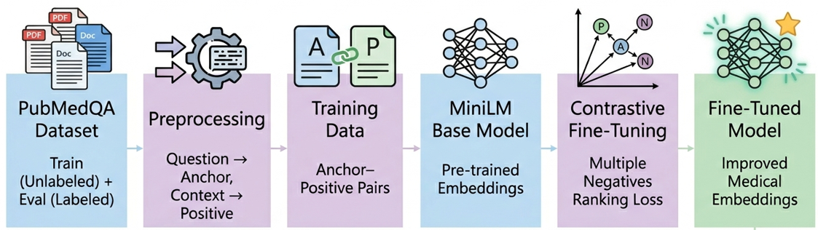
Fine-tuning Embedding model
What is Contrastive Learning?
A representation learning technique that trains models to distinguish between similar and dissimilar data samples.
Training Objective:
Pull similar pairs closer in embedding space (Question + correct evidence)
Push dissimilar pairs apart (Question + unrelated evidence)
Implemented using InfoNCE Loss (Multiple Negatives Ranking Loss) to efficiently use all other abstracts in a batch as negative examples.
Result:
Enables models to learn complex medical semantic relationships without explicit labels.

Slide 9
Experiment Setup
Dataset:
For finetuning: PubMedQA – unlabeled split (10,000 samples)
For evaluation: PubMedQA – Labeled split (1000 samples)
Embedding models compared:
Generic Baseline: all-MiniLM-L12-v2
Domain-specialized: Our custom mini-pubmedqa-finetuned
Generator: Llama-3.2-1B-Instruct (prompted for strict Yes/No/Maybe outputs).
Infrastructure:
Weaviate Cloud (Vector DB)
SentenceTransformers
LangChain
Google Colab (T4 GPU)
Gradio UI
Notes:
By putting the rank of the document in the denominator, it penalizes the documents that are ranked lower in the list.
https://docs.weaviate.io/weaviate/concepts/search/hybrid-search
https://weaviate.io/blog/hybrid-search-explained

Slide 10
Accuracy Evaluation
Overall Accuracy
Embedding Model | Accuracy | Correct | Total
all‑MiniLM‑L6‑v2 | 54.50% | 545 | 1000
mini‑pubmedqa‑finetuned | 54.70% | 547 | 1000
Class‑Wise Performance:
Class | all‑MiniLM‑L6‑v2 | mini‑pubmedqa‑finetuned
Yes | 58.33% (322/552) | 56.70% (313/552)
No | 65.98% (223/338) | 68.93% (233/338)
Maybe | 0.00% (0/110) | 0.91% (1/110)
Notes:
By putting the rank of the document in the denominator, it penalizes the documents that are ranked lower in the list.
https://docs.weaviate.io/weaviate/concepts/search/hybrid-search
https://weaviate.io/blog/hybrid-search-explained

Slide 11
Conclusion
Built a complete, end‑to‑end Medical RAG system.
Successfully fine‑tuned medical embeddings using contrastive learning.
Integrated Weaviate vector search to retrieve verified PubMed evidence.
Compared generic vs. domain‑fine‑tuned embeddings.
Generated evidence‑grounded answers with citations.
Notes:
By putting the rank of the document in the denominator, it penalizes the documents that are ranked lower in the list.
https://docs.weaviate.io/weaviate/concepts/search/hybrid-search
https://weaviate.io/blog/hybrid-search-explained

Slide 12
Future Work
Hard Negative Mining: Train the embedding model with closely related but incorrect abstracts (hard negatives) to force the model to learn finer clinical distinctions.
Advanced RAG Architectures: Implement Cross-Encoder Re-ranking models to re-order retrieved documents for even higher precision.
Real time clinical Expand the Dataset: Train on broader, highly diverse clinical corpora such as MIMIC-III (electronic health records) or full-text PubMed articles.
Rich Answer Generation: Expand the LLM prompt to generate detailed, heavily cited clinical summaries rather than simple Yes/No/Maybe outputs.

Slide 13
Demo

Slide 14


